Slide 1
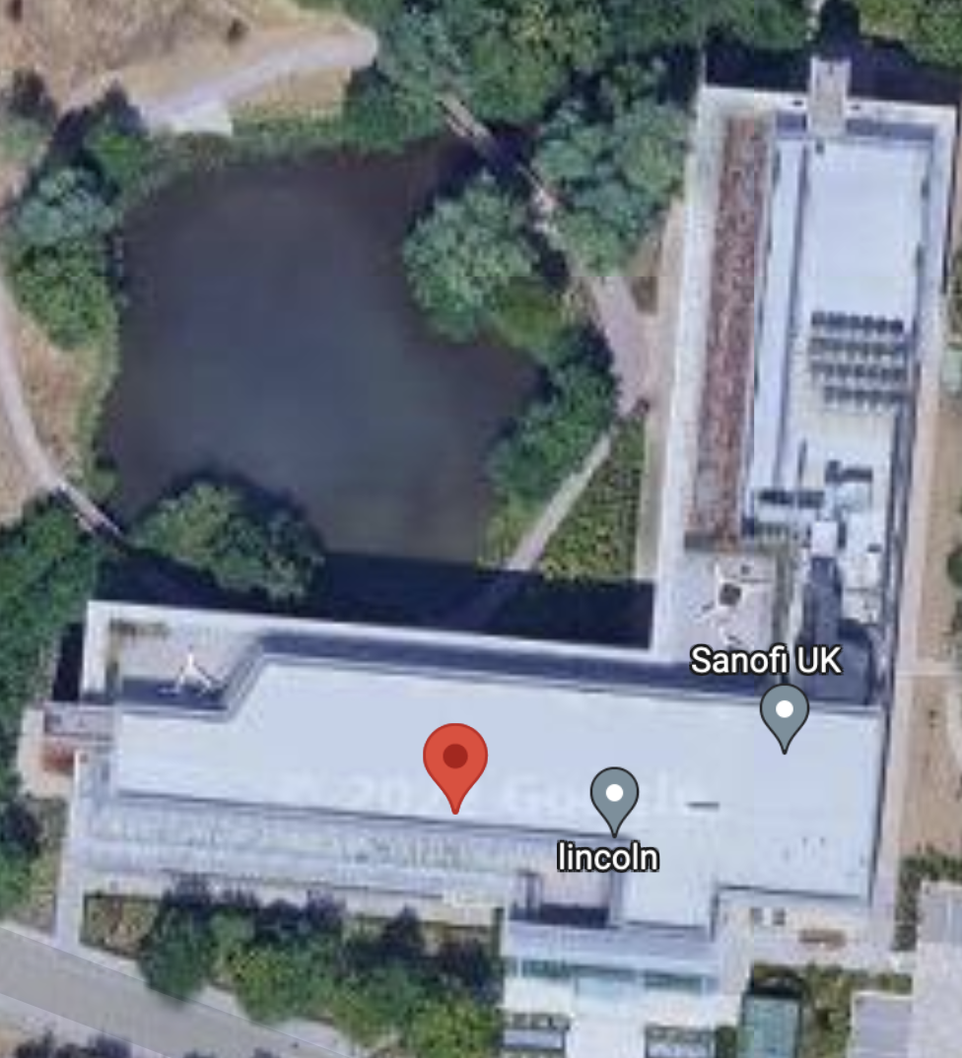
Define designated space

Slide 2
Define designated space
1st floor layout
Assumption:
“Time spent in designated areas reveals job responsibilities”
Canteen
We utilize only two floors of data
1st floor
Manufacturing facility
2nd floor
- Working office
Laboratory
Assembly line
Control room
Storage
Admin office building
Entrance

Slide 3
Define designated space
2nd floor layout
Assumption:
“Time spent in designated areas reveals job responsibilities”
IT office
We utilize only two floors of data
1st floor
Manufacturing facility
2nd floor
- Working office
Engineering room
Conference rooms
Canteen
Trainning center
Entrance

